Slide 1

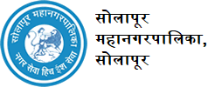
“SAMVED” HACKATHON 2026
TITLE PAGE
Problem Statement ID – 04
Problem Statement Title- Semi-Automatic Manhole Cleaning Machine
Theme- safety & Assistance for sanitation workers
Team ID- MITVPU_SAMVED_Team1
Team Name : SURAKSHA

Slide 2
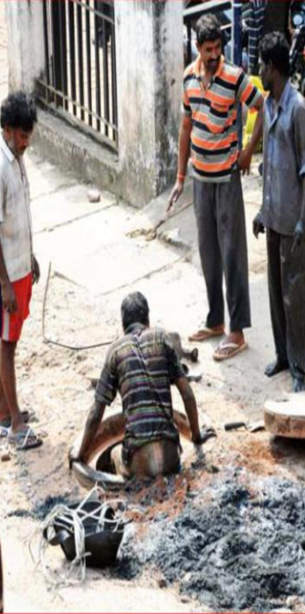
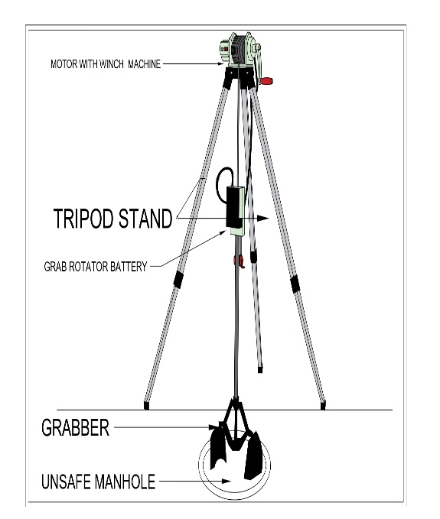
Semi-Automatic Manhole Cleaning Machine
Team:
SURAKSHA
Proposed Solution:
Semi-Automatic manhole Cleaning Machine, a portable tripod with hand crank/electric, and a clamshell grabber for remote debris removal from sewers, ensuring zero-entry for sanitation workers.
We approached sanitary workers and identified that they were facing difficulties in extracting waste from the manhole.
Innovation and uniqueness:
Mechanical lift optimization
zero-entry safety design
Precision cleaning for confined urban spaces
Bridging the gap between manual labour and
heavy machinery

Slide 3
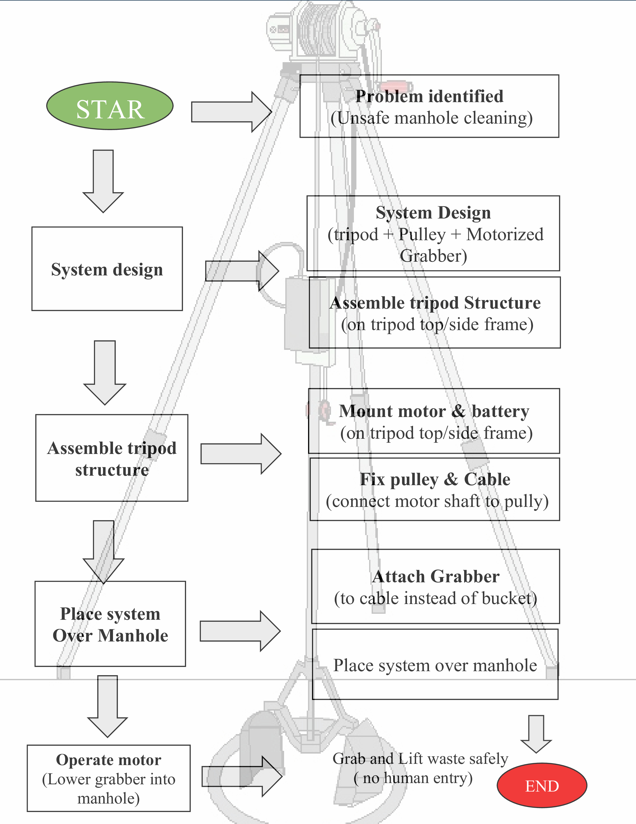
TECHNICAL APPROACH
Team:
SURAKSHA
Technologies used:
Mechanical & structural technology
Grabbing and desilting technology
Safety and material technology
Methodology:
Problem identification – Unsafe manual manhole cleaning
System design - Tripod + pulley + motor + battery + grabber
Material selection – lightweight, strong, corrosion-resistant
Assembly – Tripod setup, motor, and grabber integration
Installation – placed over a manhole, stable alignment
Operation – Motorized lifting, waste grabbing
Testing – load & safety check
Evaluation – safety, efficiency, ease of use

Slide 4
FEASIBILITY AND VIABILITY
Team:
SURAKSHA
Feasibility Analysis:
Uses simple and easily available components (tripod, grabber, motor & battery).
Low cost and easy to operate.
Improve worker’s safety by avoiding human entry into the manhole.
Suitable for municipal and small-scale use.
Potential challenges and risks:
Mechanical wear of pulley, cable, or grabber.
Battery or motor failure.
Overloading of the system.
Operation in a wet and corrosive environment.
Strategies for overcoming these challenges:
Use strong, corrosion-resistant material.
Perform regular maintenance and inspections.
Follows safe load limits.
Use reliable batteries and basic operator training.

Slide 5
IMPACT AND BENEFITS
Team:
SURAKSHA
Potential impact on the target audience:
Reduce the health risks of sanitation workers.
Improves the safety and dignity of the laborers.
Ears to Use with minimal training.
Benefits of the solution:
Social: Prevent Manual scavenging and improve worker safety.
Economic: Low-cost system, reduce Medical and Expenses.
Environment: Cleaner manholes, reduce waste spillage.

Slide 6
RESEARCH AND REFERENCES
Team:
SURAKSHA
MoHUA-SOP for Sewer and septic tank Operations
https://mohua.gov.in/upload/uploadfiles/files/AMRUT%20SOP%20Book%20Final.pdf
Ban on Manual Sewer Entry &Use of Machines
https://timesofindia.indiatimes.com/city/gurgaon/gurgon-civic-body-tightenscurb-on-manual-sewer-entry-safety-gear-must/articleshow/122785149.cms
Manual scavenging – Overview& risks:-
https://en.wikipedia.org/wiki/Manual_scavenging
Hazardous Cleaning Issues in India:-
https://anantamias.com/current-affairs/hazardous-cleaning-and-manual-scavenging/
SOLINAS Technologies - Innovation in Locating [Plastic Pipe, NonMetallic Pipe, Lead Pipe]

